Slide 1
Would I Skip It? Predicting Song Skips Based on Lyric Content
Notes:
Good Afternoon,
Today I will walk you through my steps

Slide 2
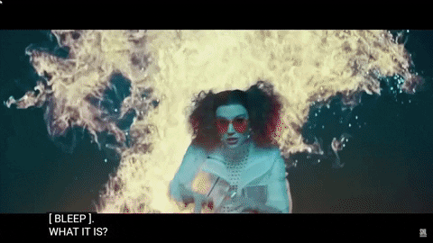
The Problem
The Goal
Streaming service algorithms that pay closer attention to user skipping behavior and reasons
Notes:
When listening to music, one of the main things that will make me skip a song is if the artist sings their own name in the track.
Searching online I noticed that I am not the only one who cringes when hearing this. SNL has an entire skit on artists self-announcing, before the songs even begin.
Jason Derulo is one of these artists who has done it so much that someone decided to make a 57 minute long compilation video of Jason Derulo singing his own name, of which I will spare you the cringiness, however if you really want to see it, I’ll send you a link later.
Ultimately it would be nice if streaming services such as Spotify would get better insight into why a user skips a song, in my case they would detect that I skip songs when the artist decides to self announce, with this information, they could leave out such songs when they suggest a playlist.

Slide 3
The Data
Spotify and Genius API
128 Artists
~ 100 Tracks from Each Artist
Notes:
Initially I wanted to use a dataset provided by Spotify to Crowd AI for their Skip Prediction Challenge, however this dataset did not have any track or artist identifiable information. I wanted to get insight into Spotify user behaviour when it comes to skipping songs. Once I retrieved the lyrics for those tracks I wanted to see if artist self-announcement was a factor in their skip behaviour.
Since this dataset did not have any identifiable information, I decided to pull all tracks from playlists created by Spotify. With the tracks in hand I was able to retrieve the artist name, song titles, and other audio features such as the acoustics, duration, and danceability of the songs.
I then compared my gathered data’s duration column to the Challenge dataset to see if there were any matches. Of the 145k rows that I had gathered, there were only 6k that matched the Challenge dataset realizing that this number would continue to decrease as I matched additional columns, I decided to pivot my project to a more personal playlist.
Using the Spotify and Genius API I made a list of 128 artists, and gathered approximately 100 tracks with lyrics from each artist. The artists were a mix of those that I knew self announced and others that I liked.

Slide 4
Data Cleaning
‘Duplicates’
[Chorus][Intro] tags
Unicode & linebreaks ( \n )
Alias : Pitbull Mr. Worldwide, Mr. 305
Target:
1 | If artist or featured artist sings their name / alias in song
0 | If artist or featured artist does not sing name / alias in song
Notes:
Because I requested 100 tracks from each artists, I ended up getting some duplicates. After Genius iterated though songs for the artist, it attempted to fill the requirements with Remixes or different 'versions', but the lyrics were still the same.
Other categories that were dropped, were songs that were instrumental only (no lyrics), artists such as Diplo,
Next I moved on to string cleaning, removing line breaks and Unicode as well as chorus and intro tags, these were especially important because it listed which artist would sing said part and would therefore throw off my models.
I needed to also create an alias column because some artists such as Pitbull would call themselves Mr. Worldwide or Mr. 305
To create a target column I would iterate through the lyrics column, and check if any of the values in the Artist, Featured Artist or Aliases columns were in the lyrics, if true the target would be set to 1 if not then 0.

Slide 5
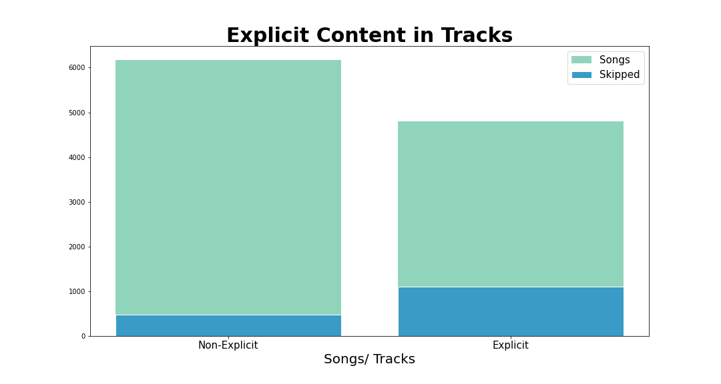
Notes:
This is the explicit tracks breakdown in my dataset. Even though there were higher counts of non-explicit content in my dataset, I skipped 1466 explicit songs and 689 non-explicit content.

Slide 6

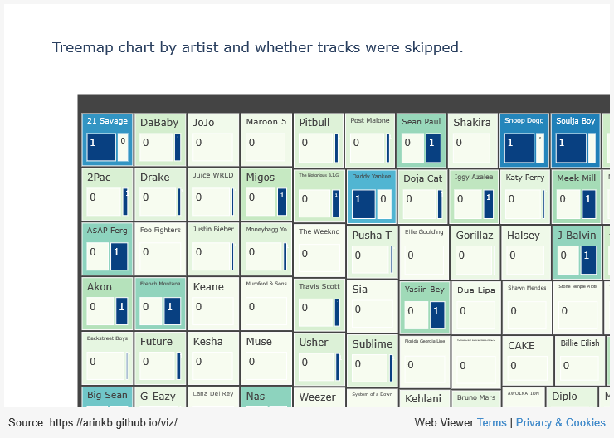
Notes:
An overview of all artists and their skipped songs breakdown.
21 Savage has 72 songs that I would skip and 28 that I would not.
Surprisingly, Jason Derulo who was the main artist I could think of that I would skip songs based on this specific trait of singing their own name, only has 21 songs that I would skip and 77 that I would not, this however makes sense, because in 2015 he said that he had outgrown singing his name, and just recently started doing it again, because ‘he missed it’.
Out of 100 songs, Shakira had 6 where she or a featured artist sang their name.
Of course one artist that would never let me down is Rick Astley who has a total of 97 songs and none of them worth skipping.

Slide 7
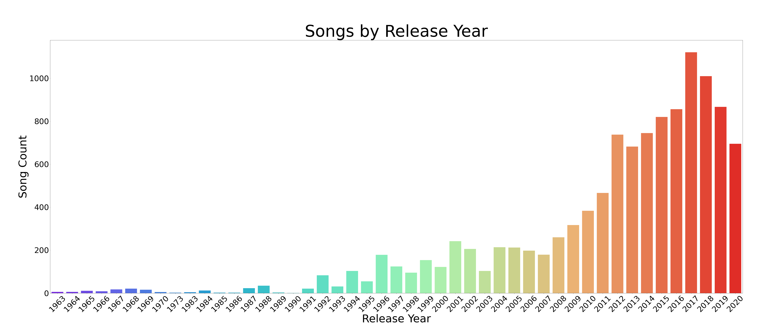
Notes:
The songs in my dataset ranged from release years 1963 to 2020. A left-skewed distribution of songs, leaning heavier on the newer artists and songs.

Slide 8
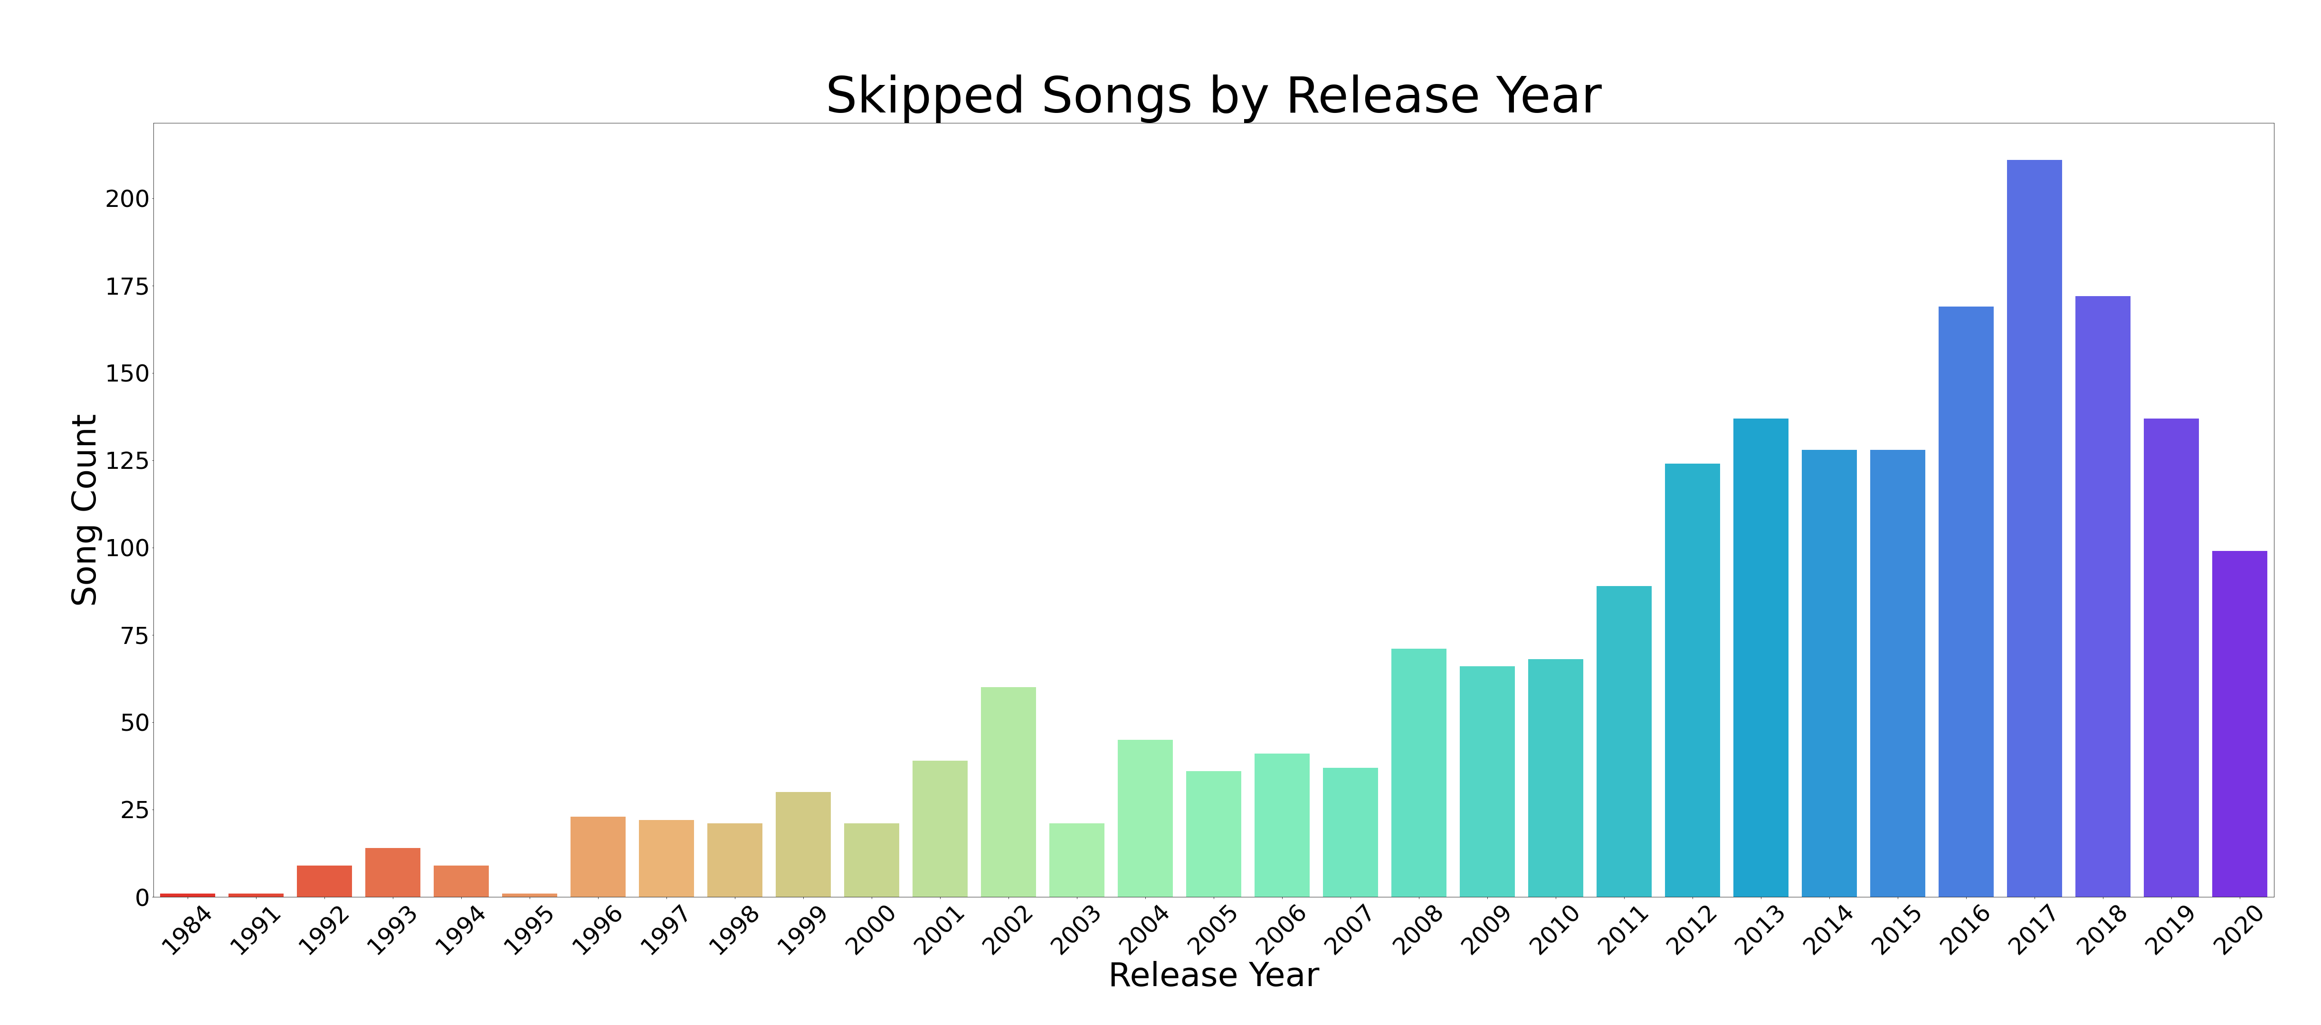
Notes:
The first occurrence of an artist using their moniker within my gathered data is in 1984 by “Weird Al” Yankovic in ‘I Lost on Jeopardy’, although it really was Don Pardo who said Werd Al’s name. Following that it was 2Pac and Sublime in 1991.

Slide 9
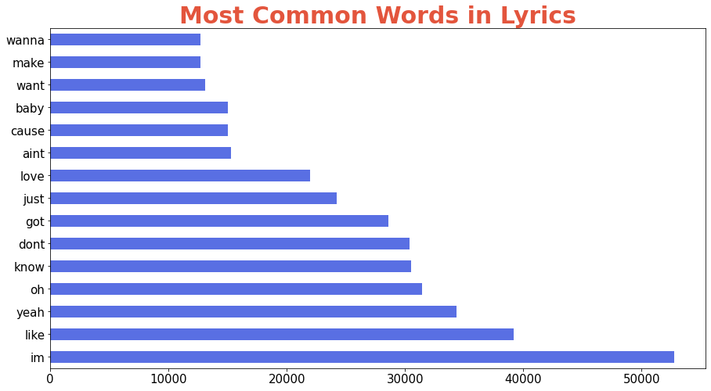
Most Common Words in Lyrics
Notes:
I used Count Vectorizer as my transformer on my lyrics column to get the most common words out of my corpus, this helps me determine what additional words I may want to add to the stop words dictionary for Natural Language Processing.
Based on these words, I left my stop words in the Count Vectorizer to the English dictionary, however I masked some words, for my model predictions.

Slide 10
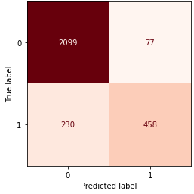
Modeling
Transformer
Count Vectorizer
TFIDF Vectorizer
Estimator
Multinomial NB
Bernoulli NB
Logistic Regression
Random Forest Classifier
AdaBoost Classifier
Notes:
Using my Pipeline function I created for my Reddit Project, which takes inputs of the type of transformer, estimator, pipeline parameters and outputs a report with scores and confusion matrix.
I put all my models through the Gridsearch Pipeline with both types of transformers and each estimator totaling 10 models initially.
Count Vectorizer splits all words in a corpus and then assigns them a boolean to whether that word is in the row or not. Then counts the number of occurrences.
Whereas Term Frequency-Inverse Document Frequency Vectorizer finds the words that are heavier in one document over the other.
These models were chosen based on how well they do on classification problems and Natural Language Processing.
My classes were imbalanced at 76% for the not_skipped songs and 24% for the skipped songs, because of this I decided to use F1 score instead of accuracy. The F1 score weighs the average of precision and recall.
Decision Trees work by learning a hierarchy of if/else questions which forces it to address both classes and therefore perform well on imbalanced data.
Boosting is a sequential model that tries to build a strong predictive model from mistakes made by the weaker base model.
My aim was to reduce false negatives. I would rather not listen to a song that should have been skipped and miss a few that I should have listened to.
Of these 10 models here the best model was the AdaBoost Classifier with CountVectorizer at bigrams and DecisionTree with a max_depth of 1 as the base model.
This model correctly predicted 2099 tracks that were not skipped, 77 tracks that were skipped but should not have been, 230 tracks that were not skipped but should have been and 458 tracks that were correctly predicted as skipped.
Going back to the intent of reducing false negatives, means that as it stands, out of the 2329 tracks that were marked as not skipped tracks (true negatives and false negatives), I will encounter 230 tracks that I will skip.

Slide 11
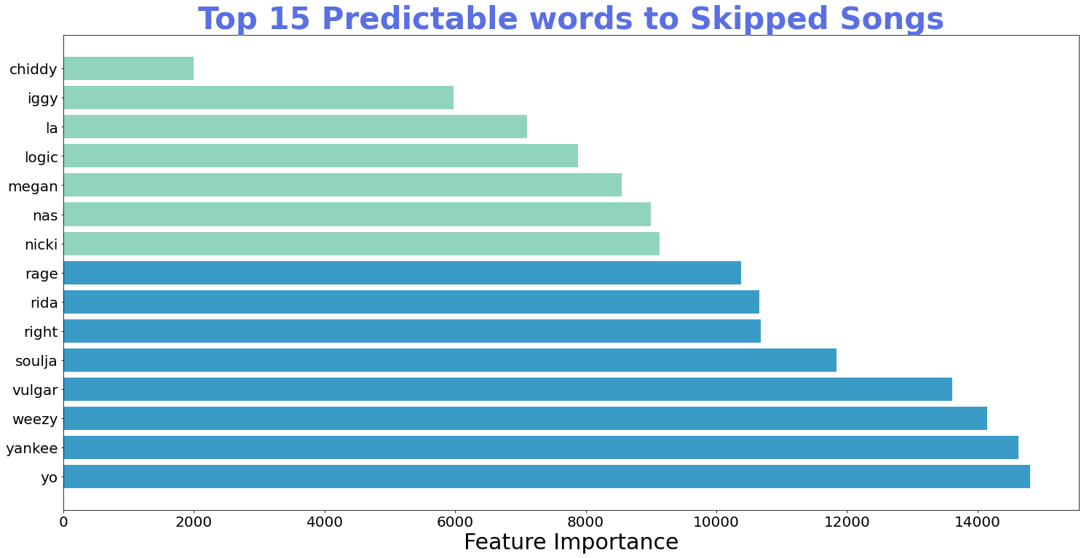
Notes:
Looking at my top 15 predictable words to the Skipped Songs class:
Apart from *'vulgar'* these words did not appear in the top 15 words in my EDA, it also makes a lot of sense as to why they have such heavy importance in determining which classes they belong to.
With the exception of *'right', 'yo', 'la'* all the other words are aliases / names of the artists.

Slide 12
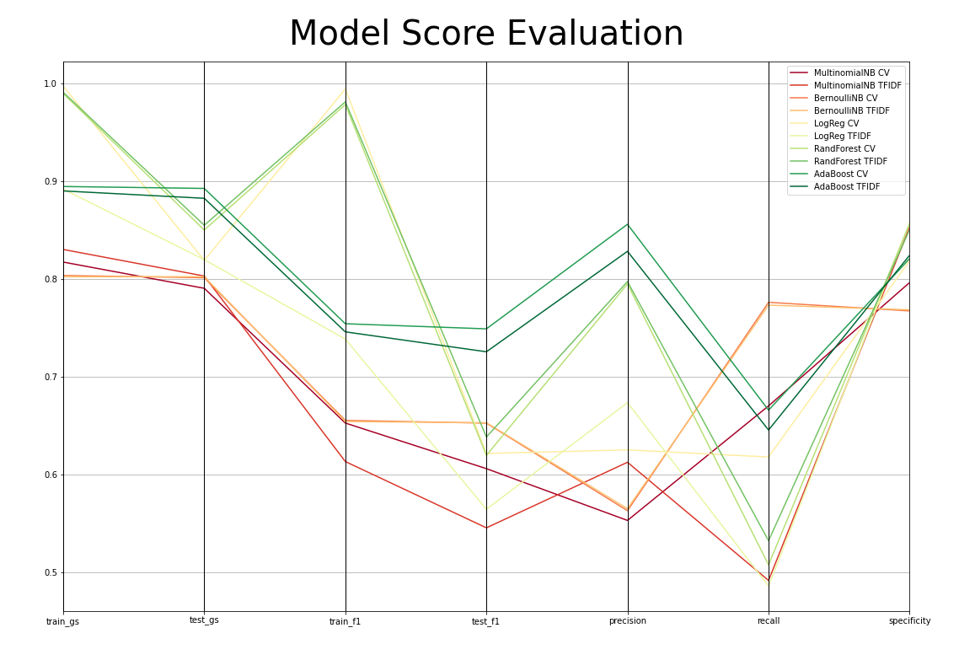
Notes:
This is all 10 model scored.
Within these first 4 ticks on the x axis, I am looking for high but equal scoring if there is too much variation between the training set and testing set scores it is an example of overfitting.
Next I am looking at high scores for precision (which indicates how many songs were correctly classified), recall (which indicates how many skipped songs were correctly classified) and specificity (which indicates how many of the not_skipped songs were correctly identified)
The RandomForest Classifier seems to score high, however there is a drastic difference between the training and testing scores.
The Ada boost classifier’s scores are steady looking at the training and testing scores. Scoring the highest on precision, above 60% on recall and like all others high on specificity.

Slide 13
Other Models
Modeling
Word Lemmatization
Best Model > AdaBoost with Decision Tree base and CountVectorizer bigrams
Scored slightly lower than non-lemmatized counterparts
Notes:
I attempted some additional model variations to see if I could get better scores, starting with Word Lemmatization which takes the words to a meaningful base from. Words like dance, danced, dancing, dances would all return to their base form of dance.
This would reduce the size of my features (unique words) and therefore result in less words the model must predict to its class. In conclusion all models scored slightly less than their non-lemmatized counterparts.

Slide 14
Other Models
Modeling
Word Lemmatization
Re-Sampling
Best Model > AdaBoost with Decision Tree base and CountVectorizer bigrams
Scored slightly lower than non-lemmatized counterparts
Random Over Sampling
SMOTE
Near Miss
Notes:
Next, I wanted to see what re-sampling would do to my best model. Using the AdaBoost model as the base model, I tried 3 different resampling methods:
Random Over Sampling which duplicates examples from the minority class in the training dataset
SMOTE which is synthetic minority over sampling technique. Which is different from the random over sampling technique because in this method, the minority class is not duplicated but rather new samples are made based on k nearest neighbors of a randomly example from the minority class.
Undersampling removes examples from the majority class in the training dataset, near miss selects examples based on the distance between the two classes. By default the technique will try to make the two classes equal in size.
Of these models the Random Over Sampler model did the best. Keeping it’s f1 scores in the lower 70s. This model found an additional 78 skipped songs at the cost of 155 non_skipped songs. Although the other 2 had an increase in true positives it was at a much higher cost of true negatives.

Slide 15
Other Models
Modeling
Word Lemmatization
Re-Sampling
WHAT’S NEXT?
Best Model > AdaBoost with Decision Tree base and CountVectorizer bigrams
Scored slightly lower than non-lemmatized counterparts
Random Over Sampling
SMOTE
Near Miss
Neural Networks - In progress
Notes:
I wanted to try my hand at some neural networks, because this is a new concept to me, there is a lot more reading and research I need to do before I can get good results. This is a work in progress that is currently yielding high true positives, minimal false negatives, however it also has higher than desirable false positives.
The words have been tokenized using the keras preprocessing library (similar to count vectorizer) and the classes re-weighted to counter the imbalance. Next, I need to consider re-sampling methods.
Once I have a good model using neural networks, I’d like to continue cleaning and exploring the Challenge’s dataset and see how unseen data will do in my model.

Slide 16
Thank You!
Questions?
Arink Bertrand
www.linkedin.com/in/arink-bertrand
Notes:
Thank You, I am open to any questions you may have.
Precision the number of true positives divided by all positive predictions. Precision is also called Positive Predictive Value. It is a measure of a classifier’s exactness. Low precision indicates a high number of false positives.
Recall - the number of true positives divided by the number of positive values in the test data. Recall is also called Sensitivity or the True Positive Rate. It is a measure of a classifier’s completeness. Low recall indicates a high number of false negatives.
accuracy will always predict on the heavier class when imbalanced
Sequential Learners, where different models are generated sequentially and the mistakes of previous models are learned by their successors. This aims at exploiting the dependency between models by giving the mislabeled examples higher weights (e.g. AdaBoost).
Feature importance – weighted average over each tree in the decision tree of the adaboost model
NearMiss-1: Majority class examples with minimum average distance to three closest minority class examples.
NearMiss-2: Majority class examples with minimum average distance to three furthest minority class examples.
NearMiss-3: Majority class examples with minimum distance to each minority class example.
Boosting in Ensemble Methods
Just as humans learn from their mistakes and try not to repeat them further in life, the Boosting algorithm tries to build a strong learner (predictive model) from the mistakes of several weaker models. You start by creating a model from the training data. Then, you create a second model from the previous one by trying to reduce the errors from the previous model. Models are added sequentially, each correcting its predecessor, until the training data is predicted perfectly or the maximum number of models have been added.
Boosting basically tries to reduce the bias error which arises when models are not able to identify relevant trends in the data. This happens by evaluating the difference between the predicted value and the actual value.

